Slide 1


SIDDHARTHA INSTITUTE OF ENGINEERING AND TECHNOLOGY
(Approved by AICTE, Accredited by NBA & NAAC A+ affiliated to JNTU, Hyderabad)
Vinobhanagar (V), Ibrahimpatnam (M), R.R. Dist. 501506.
A PRESENTATION ON
“Smart Railway Platform With Passenger Safety Gates To Prevent Level Crossing Gates Using IOT”
PROJECT GUIDE:
Mr.G.SAI RAM
M.Tech,MIAENG
Assistant Professor
Department of ECE
PRESENTED BY:
V.T. BHARGAV (19TP1A0497)
Y. ASHOK REDDY (19TP1A0499)
S. NANDINI (20TP5A0426)
T. SRAVANI (20TP5A0429)

Slide 2
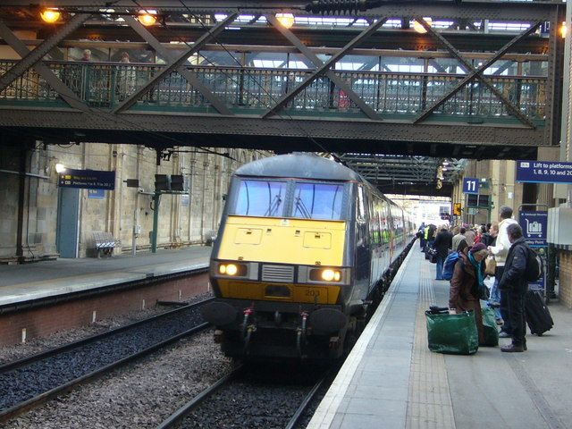
CONTENTS
INTRODUCTION
ABSTRACT
EXISTING SYSTEM
DRAWBACKS OF EXISTING
PROPOSED SYSTEM
BLOCK DIAGRAM
HARDWARE REQUIREMENTS
SOFTWARE REQUIREMENTS
FLOW CHART
ADVANTAGES
CONCLUSION
FUTURE SCOPE
REFERENCES
THANKYOU

Slide 3
INTRODUCTION
The concept of a smart railway platform with passenger safety gates to prevent level crossing accidents using IOT is an innovative solution to improve railway safety and convenience for passengers.

Slide 4
ABSTRACT
The intention of this project is to achieve control level crossings during the arrival/departure of the train using IOT.
The gate opening and closing is to be done using servo motors , which is controlled by the arduino UNO.

Slide 5
EXISTING SYSTEM
The existing system consists only “manual operations”.

Slide 6
DISADVANTAGES OF EXISTING SYSTEM
Due to only manual operation.There is chance for failure in opening and closing of gates during arrival/departure of train.

Slide 7
PROPOSED SYSTEM
In proposed system we used IOT controls along with manual operations.

Slide 8
BLOCK DIAGRAM
LCD DISPLAY
POWER SUPPLY
BUZZER
ARDUINO UNO
SERVO MOTORS
TEMPERATURE SENSOR
FAN
IOT
LDR SENSOR
LIGHT

Slide 9
HARDWARE REQUIREMENTS
SERVO MOTORS
TEMPERATURE SENSOR
LDR SENSOR
ARDUINO UNO
LCD DISPLAY
BUZZER

Slide 10
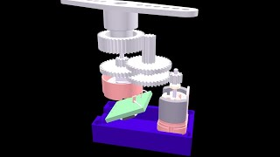
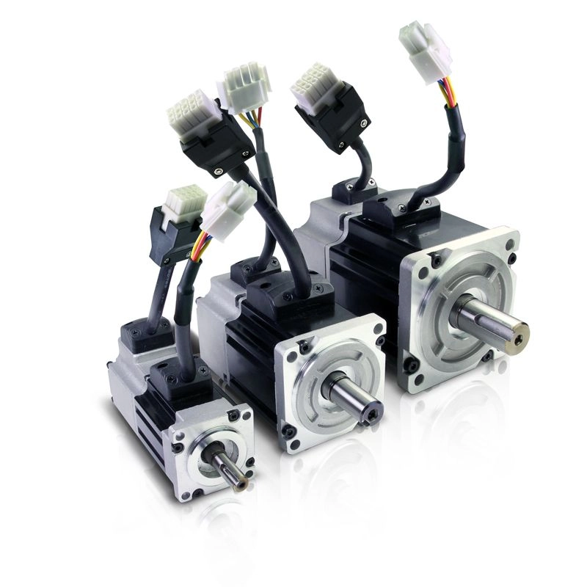
SERVO MOTORS
A servo motor is a self-contained electrical device that moves parts of a machine with high efficiency and great precision.
In this project it helps to move the safety gates for opening and closing

Slide 11
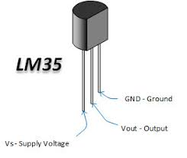
TEMPERATURE SENSOR
A temperature sensor is a device that detects and measures hotness and coolness and converts it into an electrical signal.
In this project if the temperature is high then the sensor increases the speed of fans & vice-versa.

Slide 12
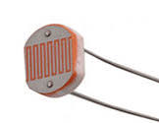
LDR SENSOR
LDR is abbreviated as “Light Dependent Resistor”.
In this project if the intensity is low then the LDR sensor switch on the lights & Vice-versa

Slide 13
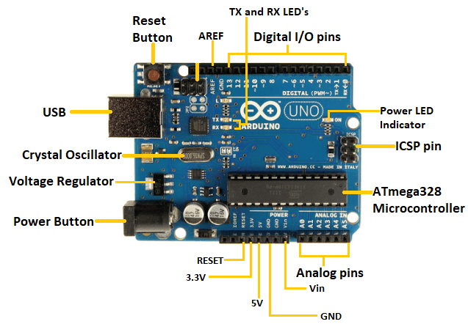
ARDUINO UNO
The Arduino Uno is an open-source microcontroller board
In this project it is used to control the servo motors rotation.

Slide 14
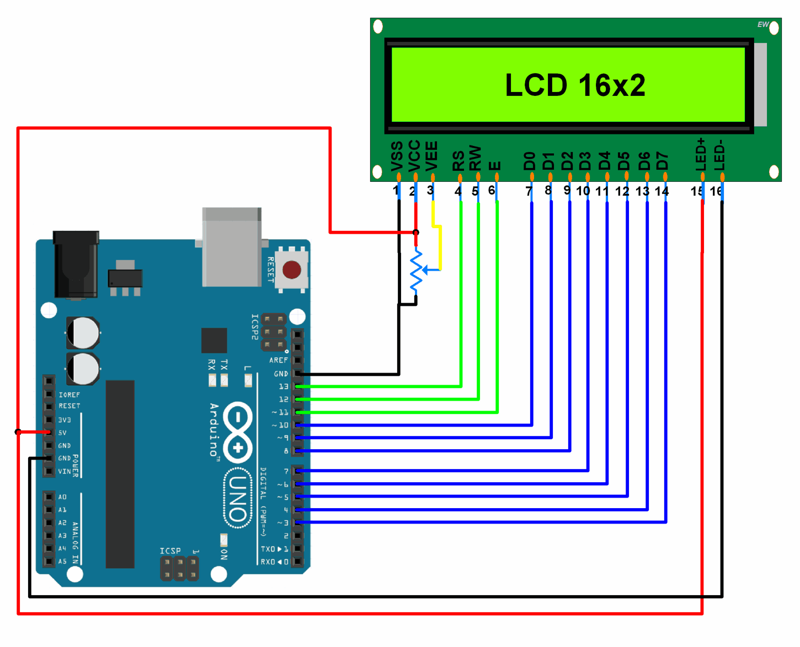
LIQUID CRYSTAL DISPLAY
LCD 16x2 is a 16-pin device that has 2 rows that can accommodate 16 characters each.
In this project it displays the output.

Slide 15
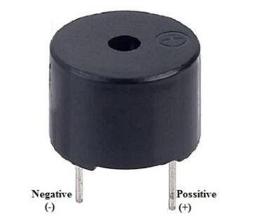
BUZZER
The buzzer is a sounding device that gives an audio signal when the gates are opening and closing.

Slide 16
SOFTWARE REQUIREMENTS
ARDUINO IDE
BLYNK IOT

Slide 17
FLOW CHART
START
When the train is near to the station.
Temperature sensor
LDR sensor
Station master
Increases the fan speed if the temperature is high
Decrease the fan speed if the temperature is low.
Blynk IOT
Manual
Switch on the light if the intensity is low
Switch off the light if the intensity is high
Safety gates will opens with a buzzer sound when the train arrives to the platform
Safety gates will closes with a buzzer sound when the train departures from the platform

Slide 18
ADVANTAGES
It reduces the man power to avoid the passengers for crossing the level gates.
The proposed system is more reliable and cost efficient.
Station master can operate the gates through IOT if incase he is not at the station.

Slide 19
CONCLUSION
By this we conclude that this project will effectively works on passenger safety at the level crossing gates during the arrival/departure of trains.

Slide 20
FUTURE SCOPE
In future this project can be developed through only IOT by automatic process by using IR sensor with respective of the platforms in the stations.

Slide 21
REFERENCES
https://www.elprocus.com/buzzer-working-applications/
https://knepublishing.com/index.php
Mendler Sandra F. and Odell William. The HOK Guidebook to Sustainable Design. Canada: John Wiley & Sons, Inc., 2000.
Railway Transportation Research Board. Guidelines for Transit Facility Signing and Graphics, TCRP Report 12. Washington, D.C.: Federal Transit Administration, 1996.

Slide 22


